Slide 1
Sourcing: Request for Proposal (RFP) and Buyer Surveys
June, 2013

Slide 2
Agenda
In this presentation and hands-on we will:
  Discuss the purpose of an RFP
  Cover the steps in creating and editing one, with a focus on the differences from RFI's and RFQ's
  Discuss the purpose of Buyer Surveys and the steps in using them
  We also discuss relevant Best Practices

Slide 3
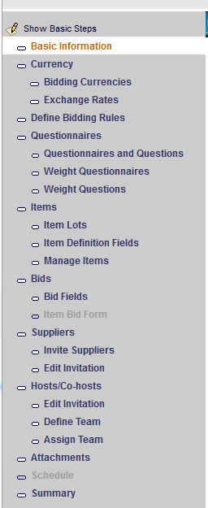
RFP Overview
RFP = Request for Proposal from Suppliers
Combination of RFI and RFQ, to obtain both written responses and pricing.
    Questionnaires and Questions as in an RFI
    Items and Bids as in an RFQ
    Very little that is unique to an RFP
Use an RFP when you want to shorten the purchasing cycle by learning about new suppliers and then quickly soliciting bids (possibly from both old and new suppliers).

Slide 4
Unique Aspects of RFP vs. RFI/RFQ
As for RFI and RFQ, creating an RFP can be done from scratch, from a template, or from an import. It's not possible to create an RFP from an RFI or RFQ template.
Invite Suppliers: You can invite Suppliers to the entire RFP, or just to specific questionnaires, questions, all items, selected items, or specific categories.
Scheduling (opening) the RFP allows the invited suppliers to respond to all elements they were invited to (previous bullet).
    However, you may want to collect questionnaire responses before deciding which suppliers to invite to bid; e.g., you could invite only new suppliers to the “RFI” phase of the RFP, then invite a subset of them, as well as old suppliers, to the “RFQ” phase.
    Use Invite Suppliers > Suspend/Include to remove or add suppliers between rounds of the event (e.g., between questionnaire analysis and bidding)
Running an RFP Report lets you gather details on both the RFI and RFQ responses of the event.

Slide 5
Demonstration and Ad Hoc Exercise: RFP
Because an RFP has no elements that are not in RFI's or RFQ's, we will not create an RFP, just look very briefly at the Wizard steps for an existing RFP. (Alternatively, create a new RFP and look at the steps.)
Login as BAM user. In Sourcing, RFx(s) → Manage RFx(s).
Filter for Created RFx(s).
Click on the RFx Name link for the Car Rental RFP (look in the RFx Type column).
Click “Show All Steps” if it appears at the top of the left pane (instead of Show Basic Steps).
Note that the RFP has both the Questionnaires steps and Items/Bids steps.
Click Close Wizard.
(You may wish to come back and examine this RFx in more detail later.)

Slide 6
Buyer Survey Overview
“Internal RFI” - Buyers collect information from a select group of buyer-side Emptoris users (non-registered internal users) over a set period of time.
Typically done after Spend Analysis and before an RFI, or after Sourcing analysis and before awarding the event
A Buyer Survey might be used to:
    Collect demand for a commodity that a buyer is preparing to source.
    Collect input from internal constituents about a supplier in preparation for a review or contract re-negotiation.
    Evaluate suppliers across a team of buyers.
Example for a customer that had 30 different suppliers of office supplies. Buyer Survey questions included:
    What do you like about Supplier X?
    Is Supplier X competitive in price?
Can also be used for non-standard input such as course evaluations

Slide 7
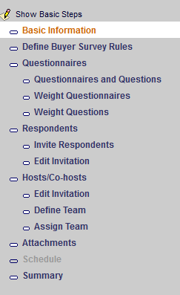
Buyer Survey Details
A Buyer Survey can be created in the same ways as an RFx: from scratch, from a template, or from an import.
Wizard steps (at right) are the same as for an RFI, except:
    Inviting “Respondents” is slightly different from inviting Suppliers. You invite either non-registered users (those without Emptoris logins), by supplying their email addresses, or internal users from a Respondent List of internal users.
    (Buyer Survey Rules are exactly same as RFI Rules)
Monitoring, Scoring and other actions for the Buyer Survey, for both buyers and suppliers, are the same as for an RFI.
Responding to Buyer Survey: Internal users: There's no Accept or Decline button, just Respond. Non-registered users get a link they follow to a Survey Response session in their browser, without a login being called for.

Slide 8
Demonstration and Ad Hoc Exercise: Buyer Survey
Because a Buyer Survey is very similar to an RFI, we will not create one, just look very briefly at some Wizard steps for an existing Buyer Survey. (Alternatively, create a new Buyer Survey and look at the steps.)
Login as BAM user, RFx(s) → Manage RFx(s), filter for Created RFx(s).
Click on the RFx Name link for the Category Management Buyer Survey.
Note that the Buyer Survey has an existing Questionnaire. Optionally examine the questions.
Click on “Invite Non-registered users” and see how they are invited; then Cancel. Click on “Invite from Respondent List”; to invite them, you check their box at the right and click the Invite link; Cancel.
Click Close Wizard and don't save.
Optionally login as one of those invited from the Respondent List and respond.

Slide 9

Questions?

